Slide 1







Analyzing Technology Trends & Demographics
Elizabeth Robles
October, 2024

Slide 2



OUTLINE
Executive Summary
Introduction
Methodology
Results
Visualization – Charts
Dashboard
Discussion
Findings & Implications
Conclusion
Appendix

Slide 3

EXECUTIVE SUMMARY
The goal of this analysis is to identify technology trends and demographics amongst developers around the globe
Data was gathered using various sources:
Job postings
Training portals
Surveys
After scraping internet sites, data was cleaned and prepared for the next step
Data was then ready for analysis using data wrangling techniques
Lastly, statistical techniques were used to identify trends and visualized in IBM Cognos Analytics

Slide 4

INTRODUCTION
This project aims to identify emerging technologies and skill trends in the developer community to help organizations stay competitive.
The three big questions to answer:
What are the top programming languages in demand?
What are the top database skills in demand?
What are the popular IDEs?
Once we are able to determine answers to these questions, the insights gathered will help organizations:
Remain competitive by staying ahead of technological advancements
Enhance hiring strategies by hiring developers with in-demand skills
Align training programs with industry needs

Slide 5

METHODOLOGY
After collecting data from various sources, I got started on data wrangling techniques to clean the data, identify duplicate rows, finding missing values, and normalize data.
Once the data was cleaned, I moved on to the data analysis phase where I began to analyze the dataset to find the distribution of data, the presence of outliers, and correlation between different columns
I used statistical methods to analyze trends in the collected data to answer the three primary questions
Created dashboards using IBM Cognos Analytics to visualize insights on:
Current technology usage
Future technology trends
Developer demographics

Slide 6
RESULTS
Key Findings from the Analysis:
Current Technology Usage:
Top programming languages in demand include JavaScript, HTML/CSS, SQL, Bash/Shell/PowerShell, and Python
MySQL emerged as the most powerful database technology
Future Technology Trends:
Developers expressed interest in learning newer technologies such as Kotlin and Go, and other developers expressed wanting to learn more established technologies such as JavaScript, HTML/CSS, and Python
Trends indicate an increasing focus on cloud-based platforms and modern frameworks
Demographics:
Majority of the respondents identified as men, with a growing representation of women
Age distributions shows most developers fall withing the 25-34 age group

Slide 7
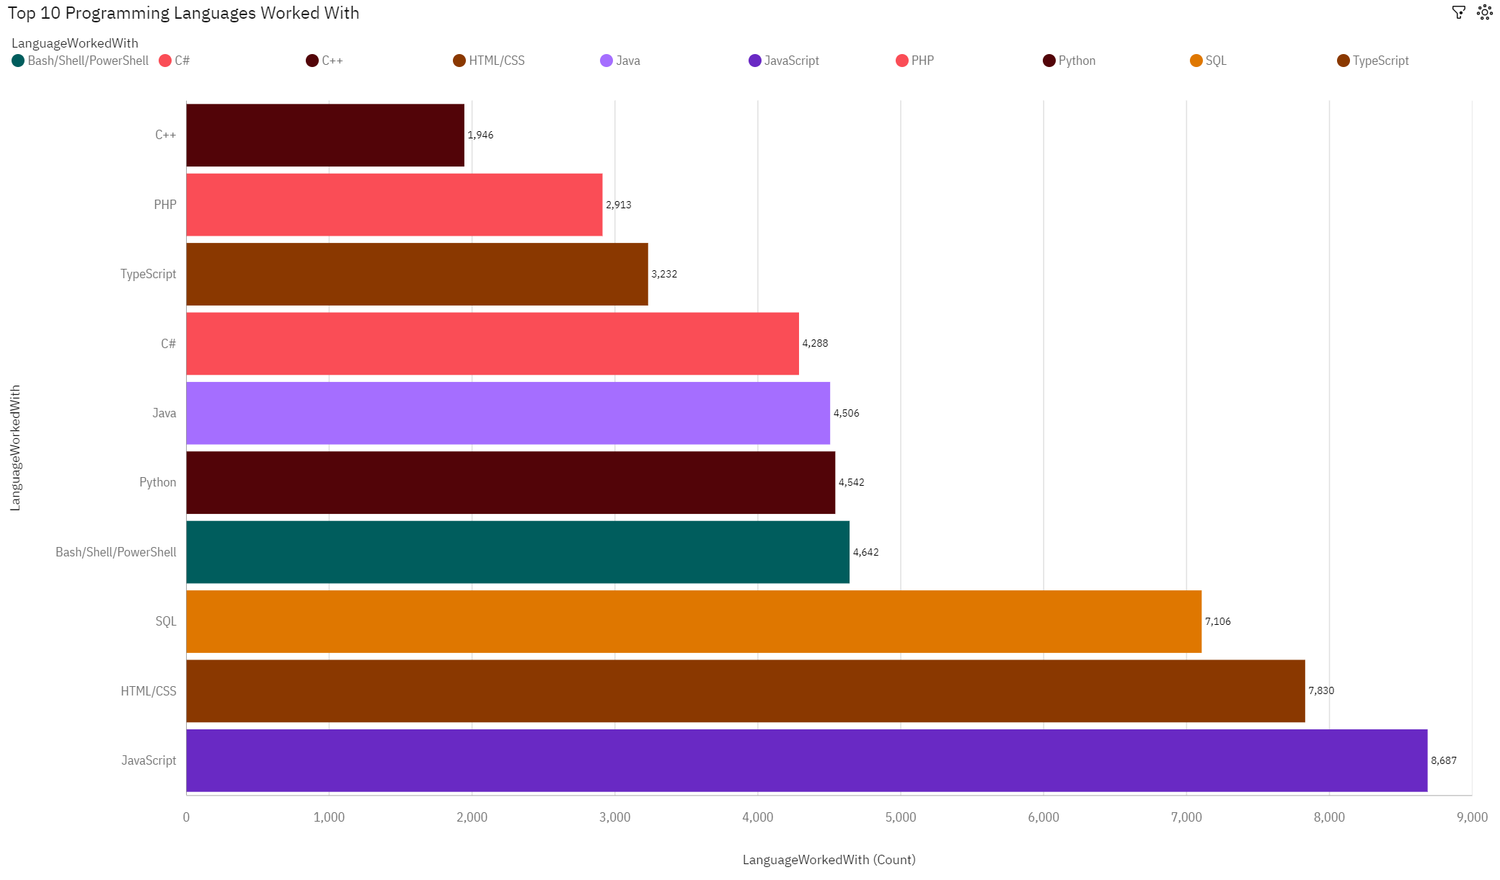
PROGRAMMING LANGUAGE TRENDS
Current Year

Slide 8
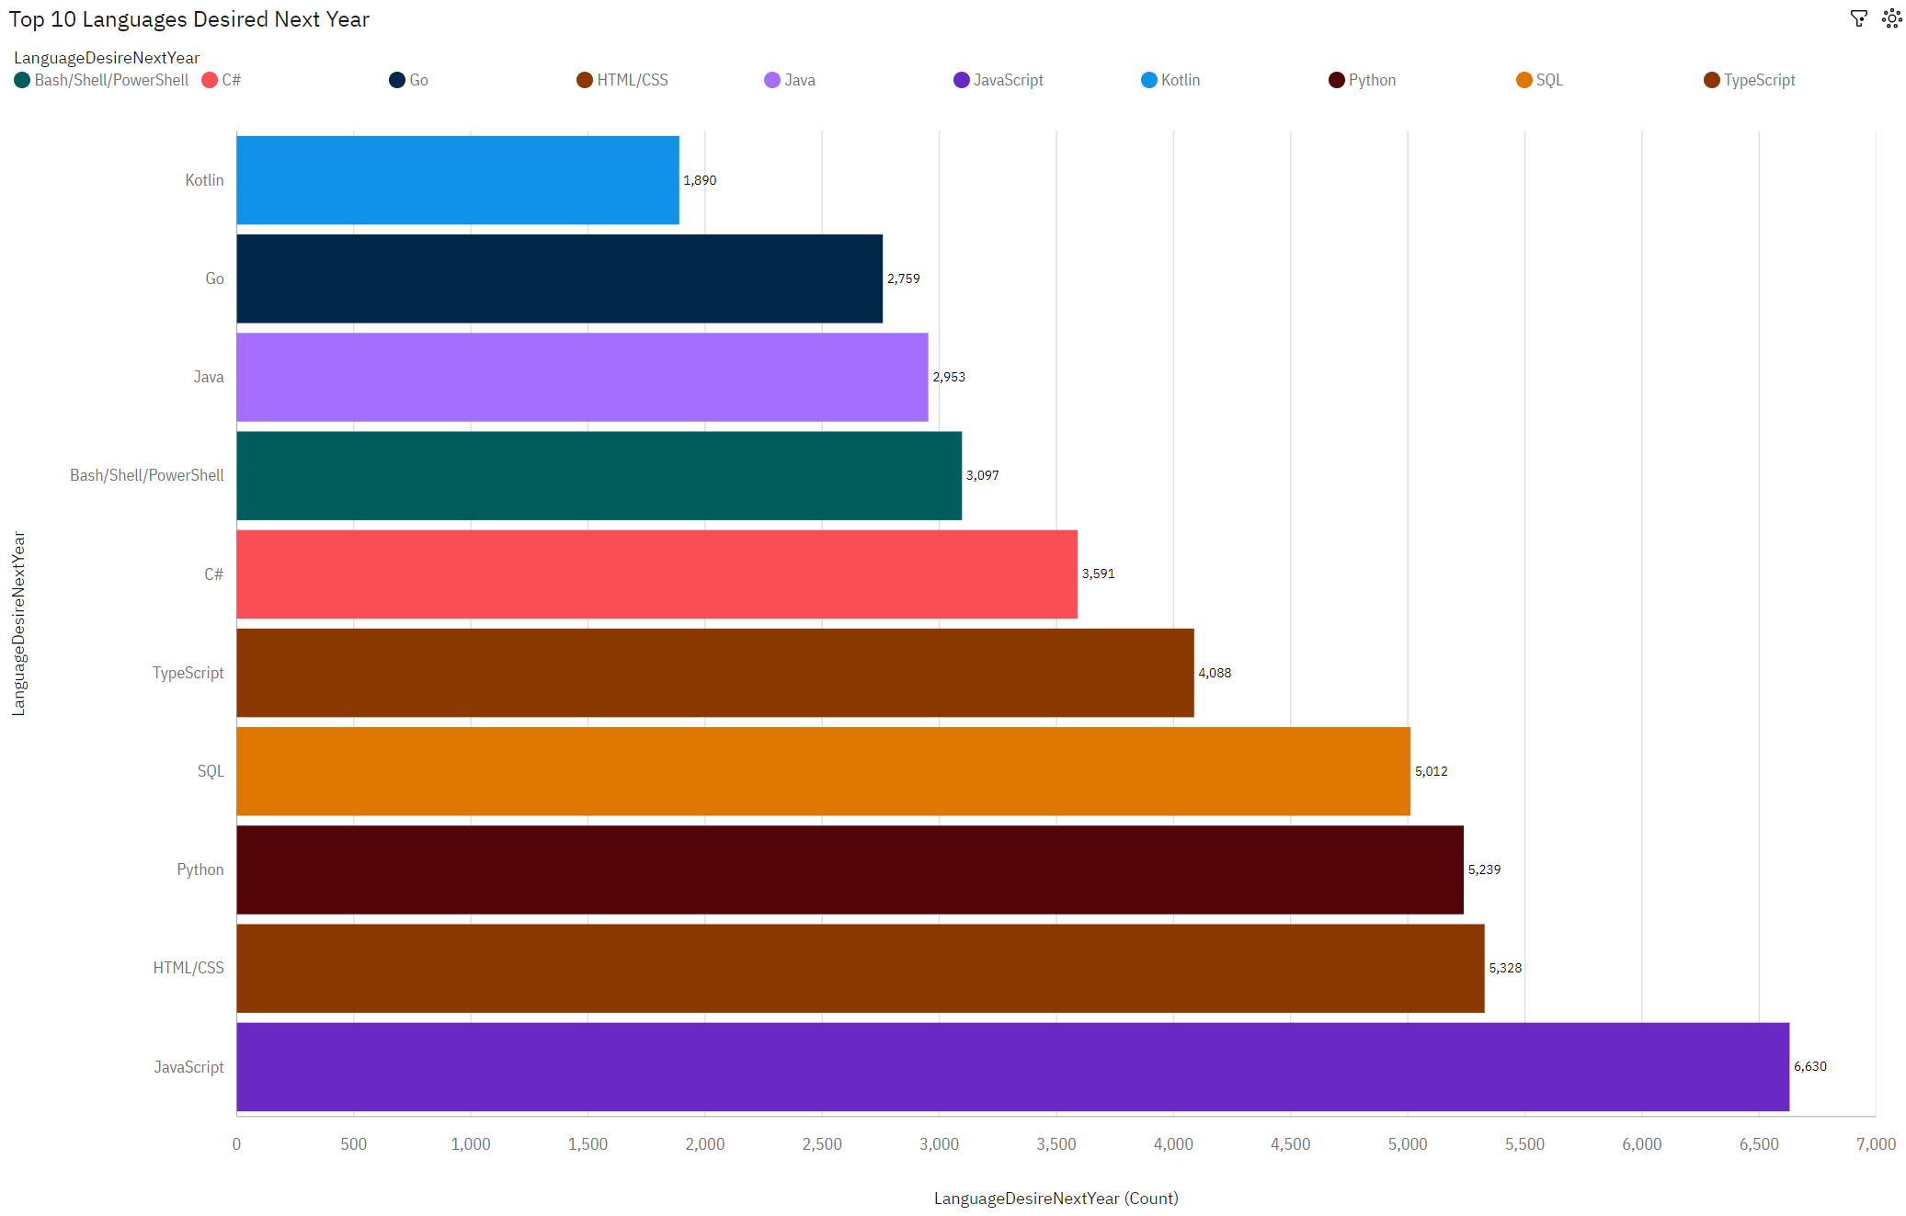
PROGRAMMING LANGUAGE TRENDS
Next Year

Slide 9
PROGRAMMING LANGUAGE TRENDS - FINDINGS & IMPLICATIONS
Findings
JavaScript is the language most used by respondents, with 8,687 actively using it, and 6,630 who want to learn it next year
SQL & Python are also highly ranked in both bar charts, showing how it will continue to be in significant demand
Newer languages such as Kotlin and Go show a trend in a desire to learn next year, even though no respondents currently use it
Implications
JavaScript will continue to be a dominant language. Organizations should prioritize JavaScript when it comes to hiring new developers & training current developers
There is a growing demand for Python and SQL, companies who are data-centric, should continue focusing on these technologies
The growing interest in newer languages suggest a need for developers skilled in modern languages

Slide 10
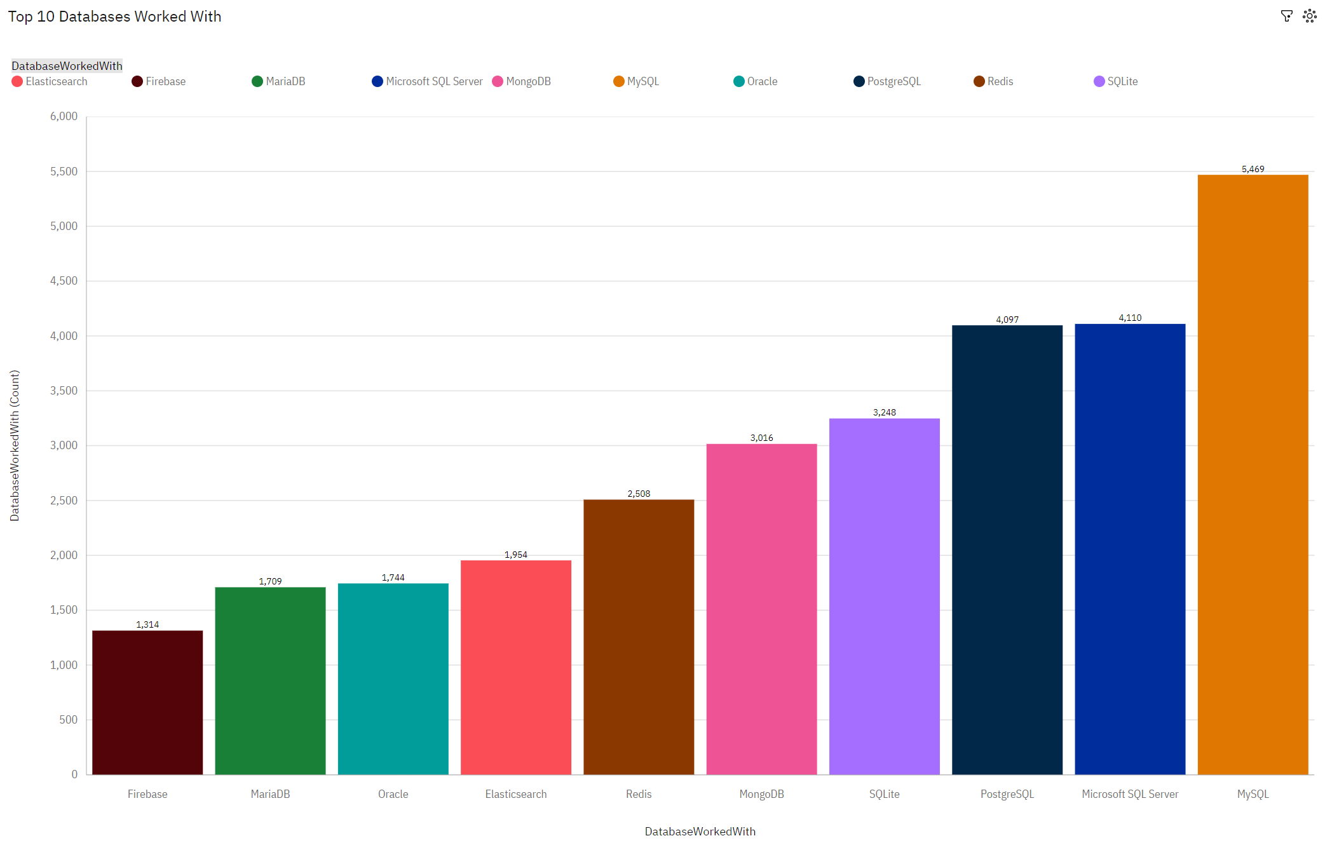
DATABASE TRENDS
Current Year

Slide 11
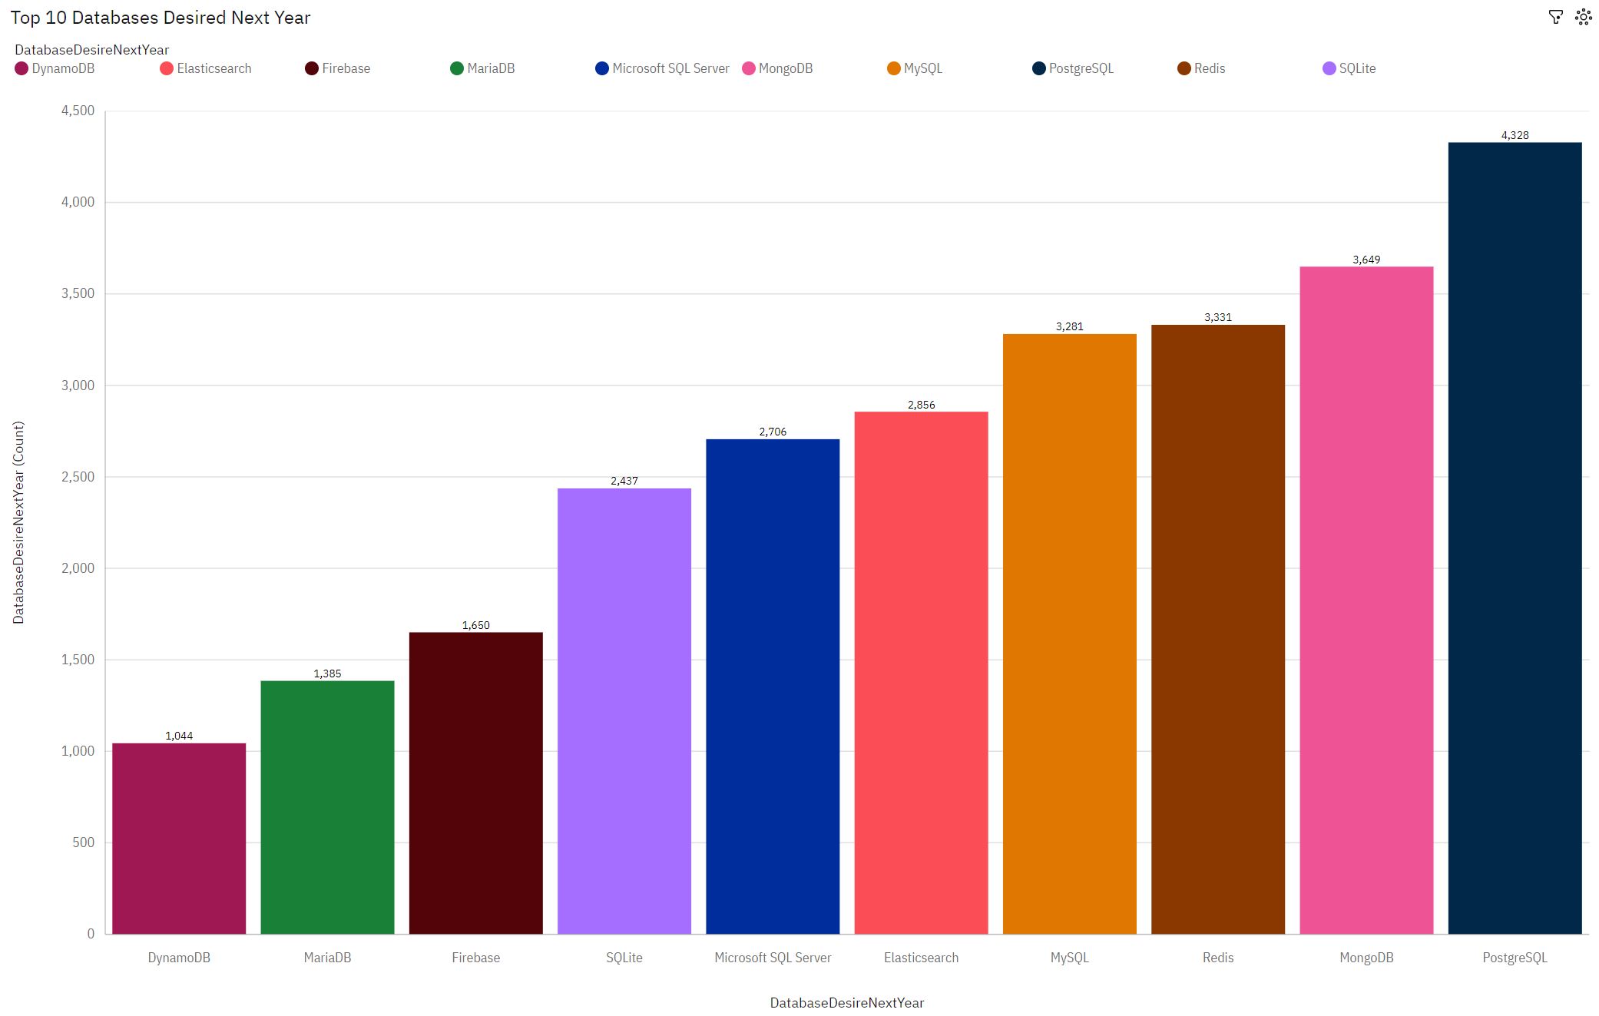
DATABASE TRENDS
Next Year

Slide 12
DATABASE TRENDS - FINDINGS & IMPLICATIONS
Findings
PostgreSQL is the most desired database to learn next year, with 4,328 respondents wanting to learn/use it, followed by MySQL with 3,281 respondents
The most worked with database is MySQL with 5,469 respondents
MongoDB shows great interest amongst respondents with 3,649 who desire to adopt it.
Implications
The databases that will likely remain dominant in the upcoming year are MySQL and PostgreSQL, so companies should continue to invest in expertise for these open-source databases
MySQL will continue to be a key database in the industry and organizations should maintain or expand their investments in MySQL resources
The rising interest in NoSQL databases such as MongoDB indicates a shift towards more flexible data solutions

Slide 13

DASHBOARD
GitHub Link to Dashboards

Slide 14
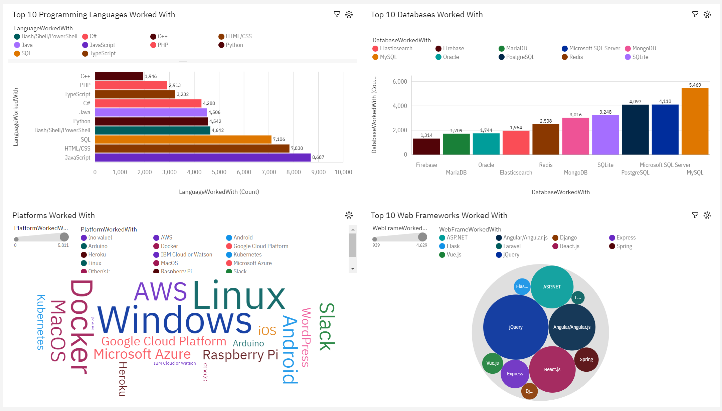
DASHBOARD TAB 1

Slide 15
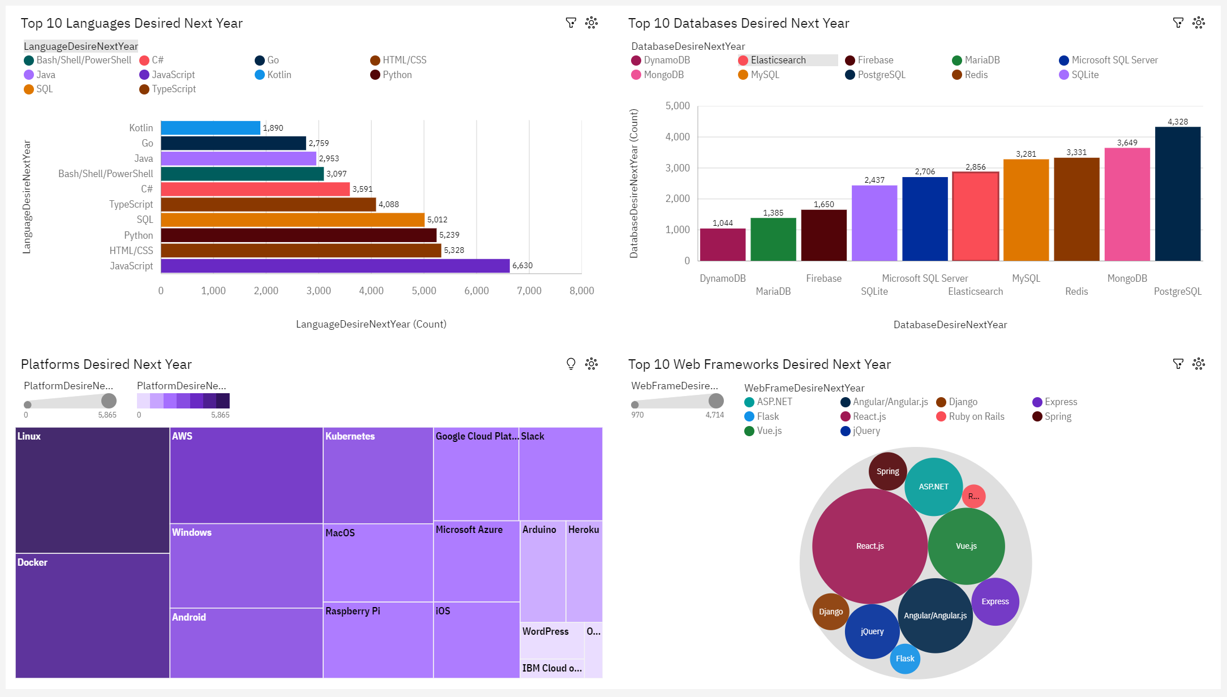
DASHBOARD TAB 2

Slide 16
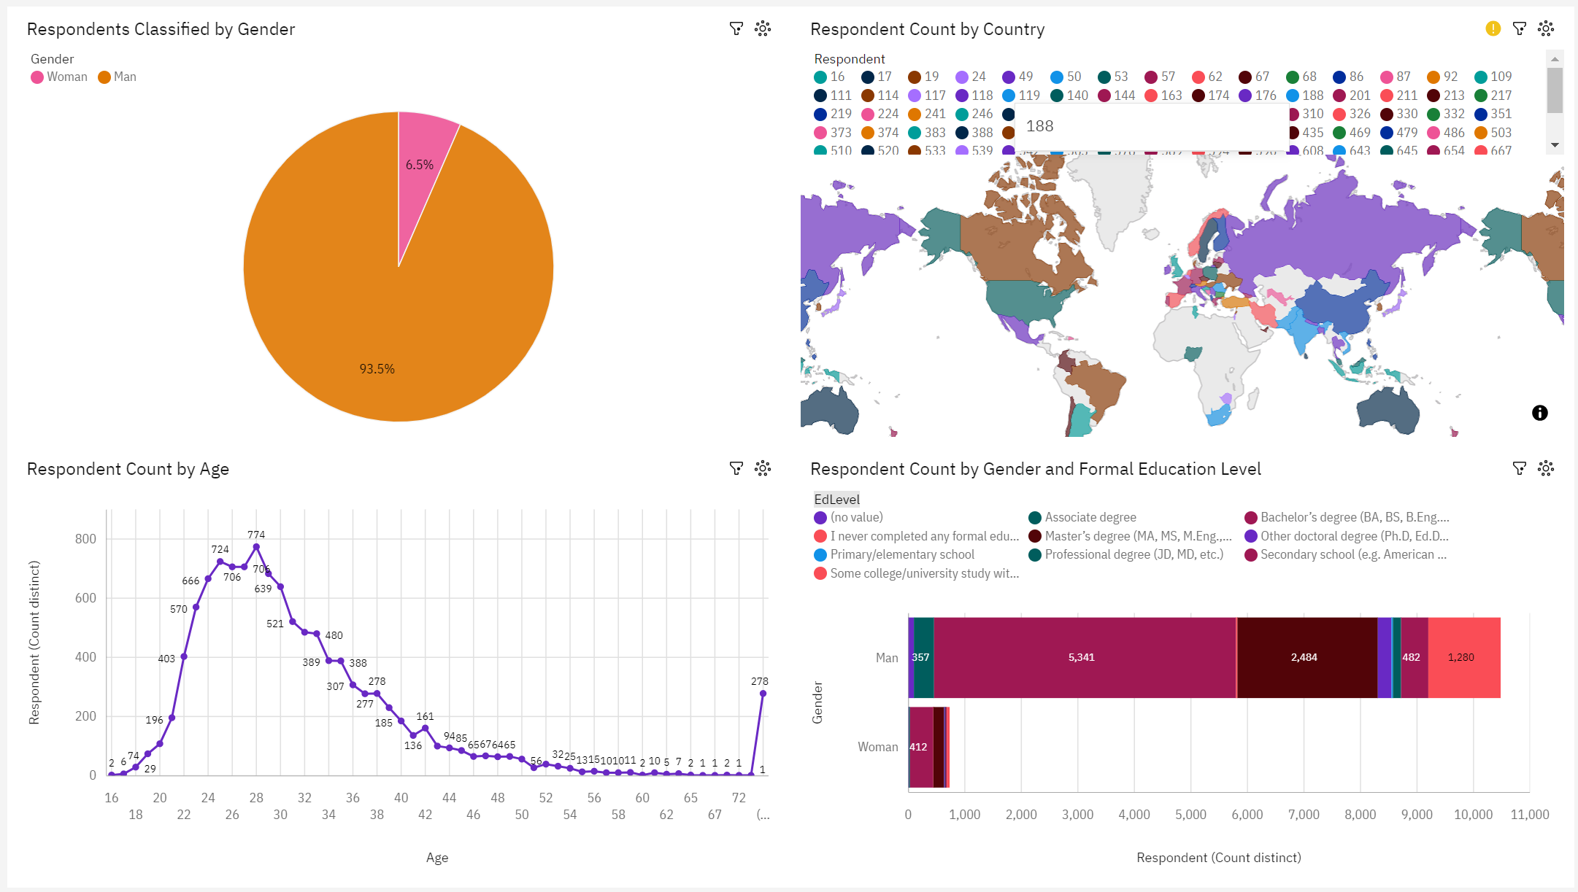
DASHBOARD TAB 3

Slide 17
DISCUSSION
Key Insights
Current technology usage reflects industry demands with top languages like JavaScript and SQL.
Emerging technologies such as Python and Kubernetes indicate future skill trends.
Challenges Faced
Data cleaning was essential to address inconsistencies across datasets.
Handling missing values and filtering relevant data required multiple iterations.
Recommendations for Further Analysis
Investigate regional variations in technology adoption.
Monitor evolving frameworks and platforms in future surveys

Slide 18
OVERALL FINDINGS & IMPLICATIONS
Findings
JavaScript, SQL, and AWS are the most widely used technologies today
Python, PostgreSQL, and React.js are emerging as future trends
The majority of respondents aged 25-34 have higher education degrees (Bachelor’s or Master’s)
Implications
Organizations should focus on upskilling employees in Python and other modern frameworks
Cloud platforms like AWS will remain critical, requiring investment in cloud infrastructure
Promoting diversity is necessary to close the gender gap in the tech workforce

Slide 19

CONCLUSION
Comprehensive Insights Gained: The analysis provided a clear understanding of current and future tech trends.
Data-Driven Recommendations: The insights will help organizations align strategies with emerging technologies.
Continuous Learning Needed: Developers should stay updated with in-demand skills to remain competitive.
Future Research Opportunities: Ongoing analysis is crucial to track evolving trends and workforce changes.

Slide 20
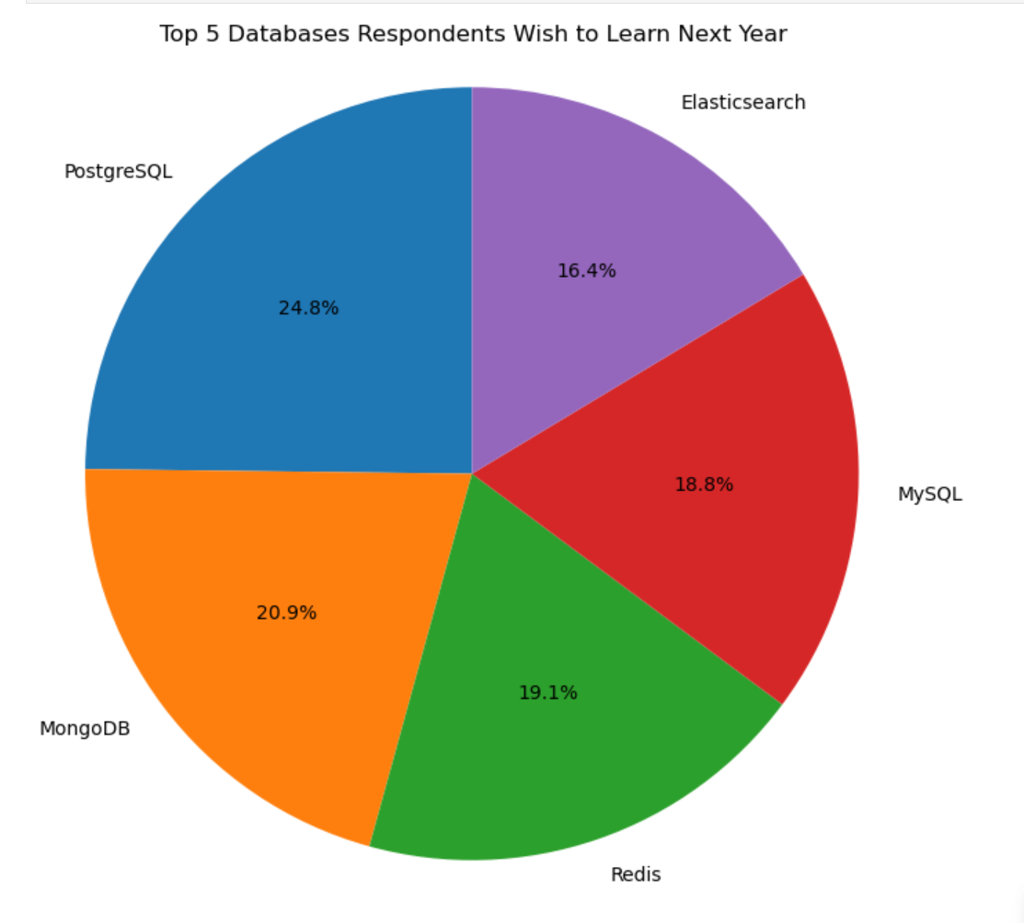
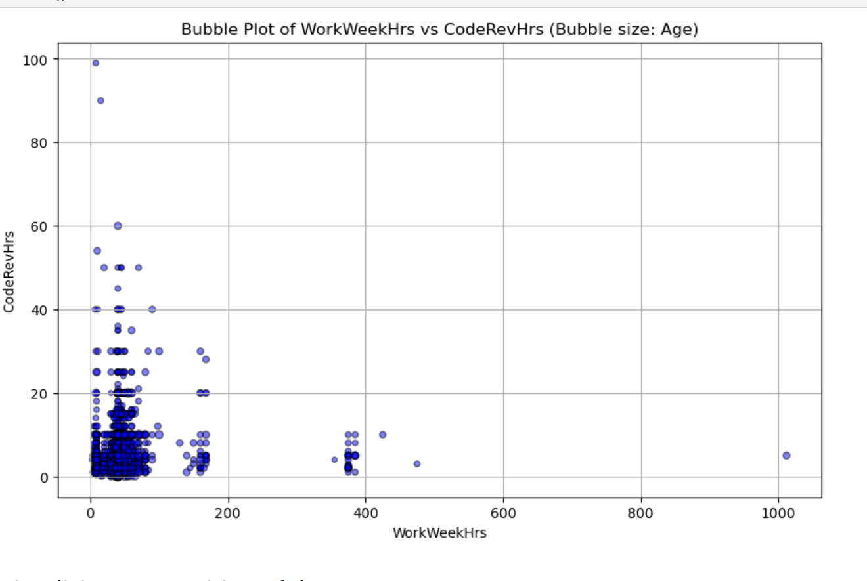
APPENDIX
Additional Insights & Visualizations

Slide 21
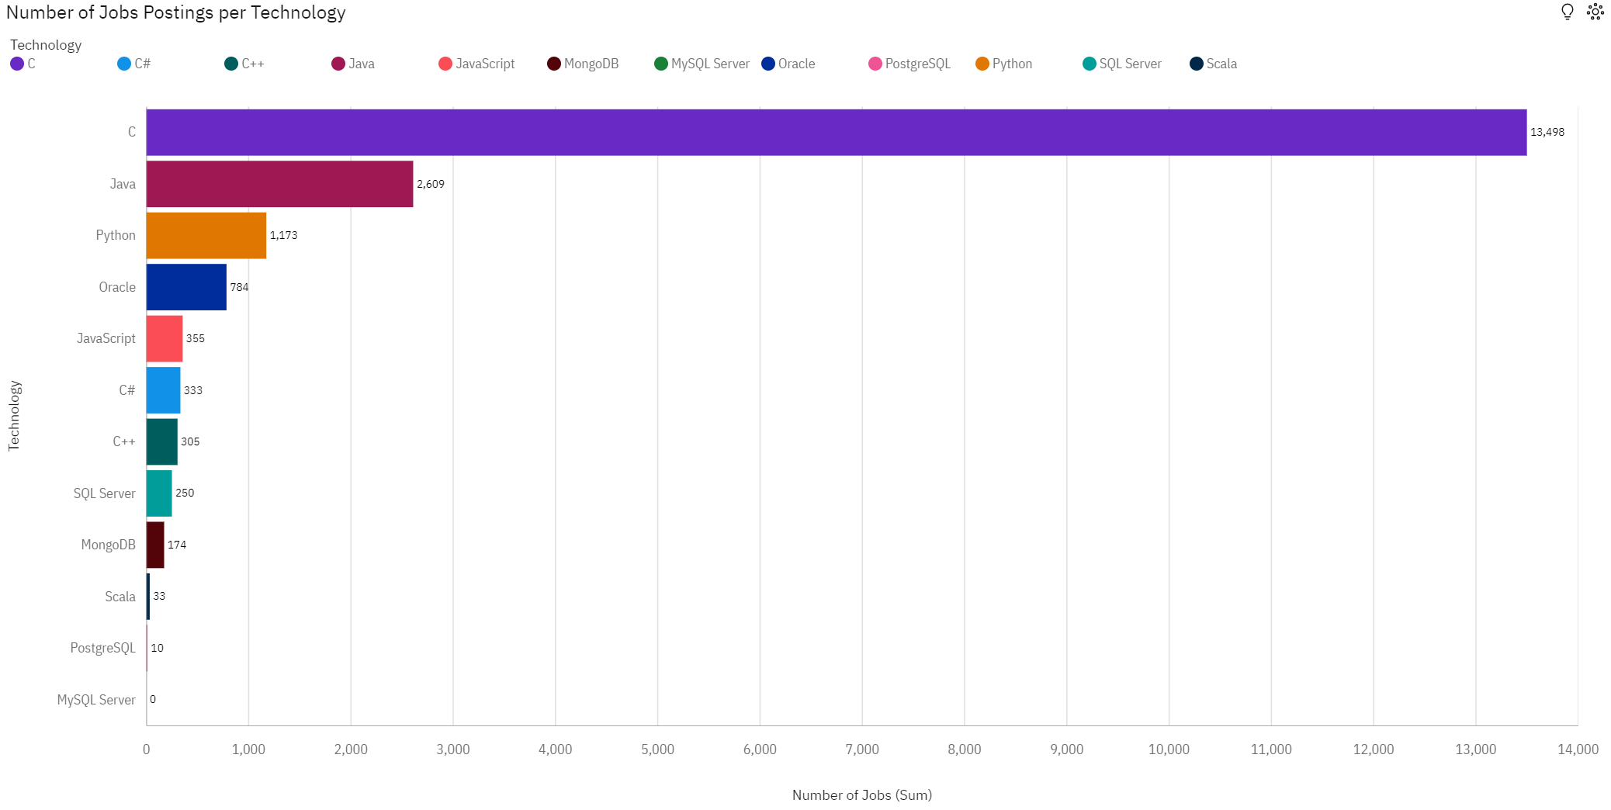
JOB POSTINGS

Slide 22
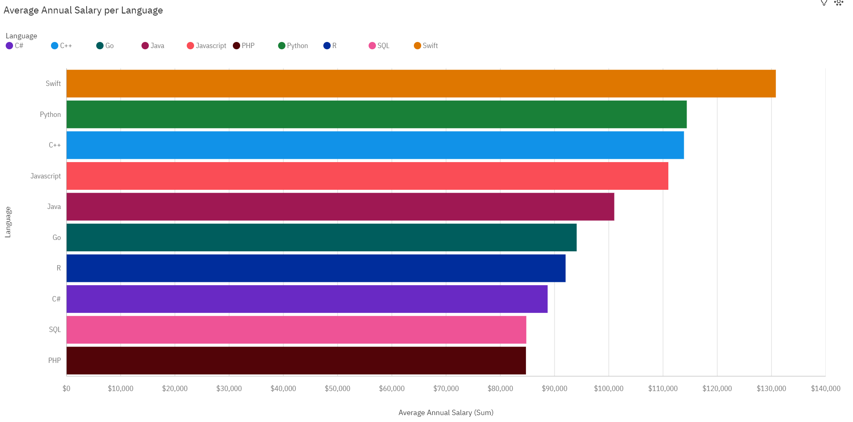
POPULAR LANGUAGES

